Slide 1
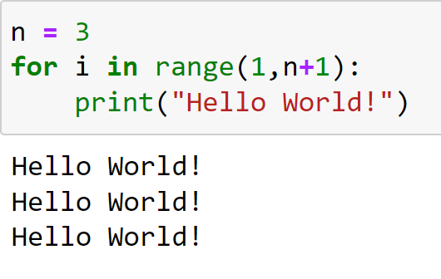
FOR Loops Programming and Algorithms
Lecture by
Dr Daniil Osudin

Slide 3
What will we Cover?
FOR loops
Introduction to functions
Using the range() function

Slide 4
FOR Loops
The body will be repetitively executed multiple times depending on the specified values of a variable and a range() function
Examples
For each of the 10 orders placed at a café, the staff need to prepare the ordered food and take the payment

Slide 5
FOR Loops in Python
Combination of the variable and range function specify how many times the body is executed
for <variable name> in range(…):
body
All statements in the body need to be indented the same
One or multiple statements in the body.

Slide 6
FOR Loops
FOR and IN are keywords
The range() function can have up to three arguments:
start (optional) – starting value – default = 0
stop (required) – stopping value
step (optional) – increment – default = 1
The range() function processes the range up to but not including the final stopping value
range(2, 7) will execute 5 times

Slide 7
FOR Loop Flow Chart
start
Body indentation
read n
n = int(input("enter n: "))
total = 0
for count in range(1, n+1):
total += count
print("the total is", total)
Variable
Start
Stop
No
Yes
i < n?
print total
total += count
count += step
end

Slide 8
FOR Loop Flow Chart
start
Body indentation
read n
n = int(input("enter n: "))
total = 0
for count in range(1, n+1):
total += count
print("the total is", total)
Variable
Start
Stop
No
Yes
i < n?
print total
total += count
count += step
end

Slide 9
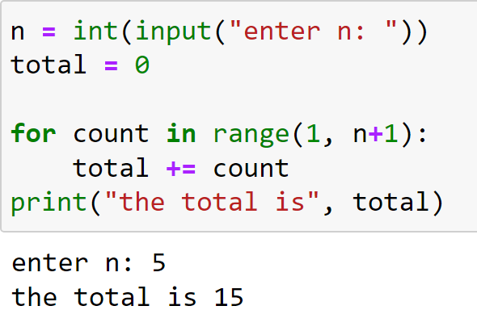
Examples
Variable
Start
Stop
Default step: 1

Slide 10
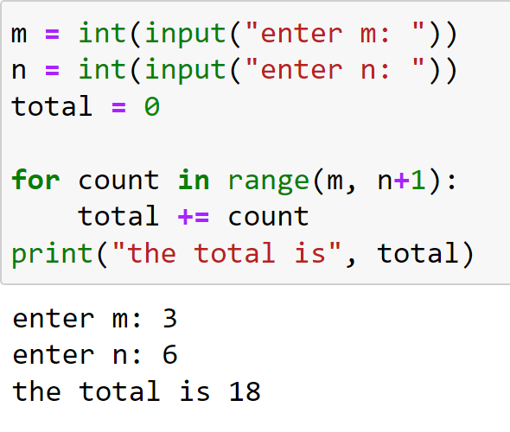
Examples
Variable
Start
Stop
Default step: 1

Slide 11
Try It Yourself
Problem 1
Write a program in Python environment that takes an input value x and prints “Hello World!” that x times using the for loop

Slide 12
Try It Yourself
Problem 2
Write a program in Python environment that calculates the sum of odd numbers from 1 to n
Hint: set the step of the range() function to 2

